Slide 1
Nous allons apprendre …
les animaux
Notes:
Nous allons apprendre les animaux = We are going to learn … animals. There follows an introduction to 8 masculine (blue background) & 1 feminine (red background) animals. These will be the animals used as examples in the next lesson with colours (and adjectival agreement) so it is very important that the pupils are confident with the gender of these nouns.

Slide 2
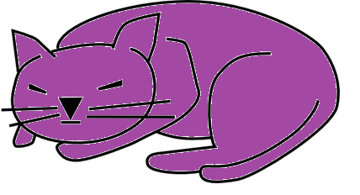
un chat

Slide 3
un chien
Notes:
Click on any part of the slide and the spelling will appear at the bottom of the box. You may want your pupils to predict the spelling before you reveal it. The hope is that pupils will be able to cope well with the spelling before of the work they have done with pronunciation and predicting spelling in the first unit.

Slide 4
un poisson

Slide 5
un ours

Slide 6
un oiseau

Slide 7
un canard

Slide 8
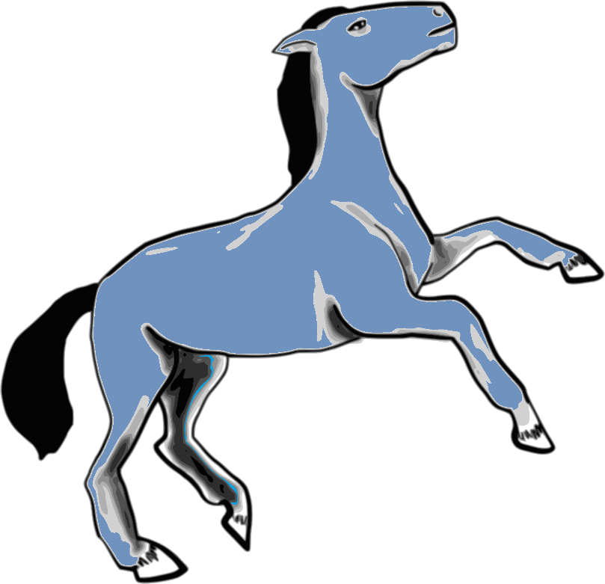
un cheval

Slide 9
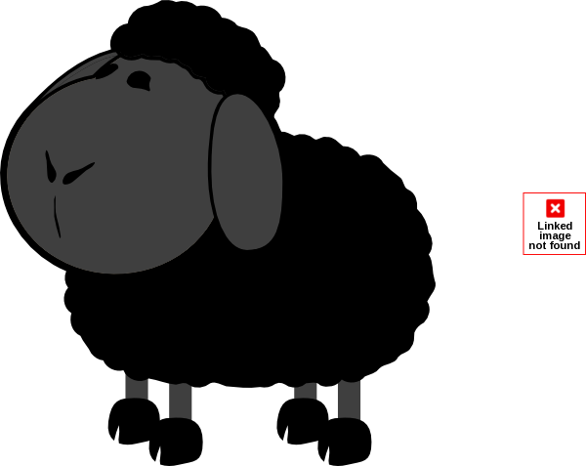
un mouton

Slide 10
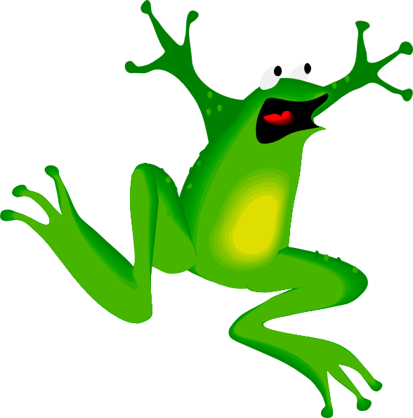
une grenouille

Slide 11
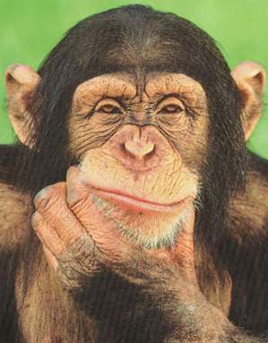
Décisions
Notes:
Decisions. In this activity pupils must choose between two animal options to identify the correct animal asked for in the question. There are various different praise words used in the audio if the pupils get the right answer. They are explained in the notes for each slide.

Slide 12
Lequel des animaux est un chat ? A ou E?
A
E
Notes:
Pupils must identify the animal asked for in the question (click to hear). I have used vowels to label the animals to allow pupils to revise/practise further the vowels from unit 1 which can pose ongoing problems with pronunciation. You may want to encourage pupils to come to the board to click on the animal to check their response is correct.
If they click on the cat they hear ‘Oui c’est vrai’ – yes, that’s correct or on the dog, they hear ‘non, c’est faux’ – no, that’s wrong.
The next slides repeat the same pattern with different animals.

Slide 13
Lequel des animaux est un chien ? E ou I ?
E
I
Notes:
This time pupils will hear ‘génial’ (great) if they get the answer right.

Slide 14
Lequel des animaux est un poisson ? I ou A ?
I
A
Notes:
This time pupils will hear ‘fantastique’ (fantastic) if they get the answer right.

Slide 15
Lequel des animaux est un ours ? U ou E ?
U
E
Notes:
This time pupils will hear mérveilleux (marvelous) if they get the answer right.

Slide 16
Lequel des animaux est un oiseau ? I ou E ?
I
E

Slide 17
Lequel des animaux est un canard ? O ou U ?
O
U

Slide 18
Lequel des animaux est un cheval ? O ou A ?
O
A

Slide 19
Lequel des animaux est une grenouille ? U ou E ?
U
E

Slide 20
Lequel des animaux est un mouton ? I ou E?
I
E

Slide 21
Plus de décisions
Notes:
More decisions. In this activity pupils must choose between two animal options to identify the correct animal asked for in the question. Encourage pupils to use ‘c’est …’ (it’s …) e.g. c’est un poisson. This activity gets pupils saying the target language vocabulary out loud without putting them under any pressure.

Slide 22
C’est un poisson ou un canard ?
C’est un poisson.
Notes:
The question is already showing on the slide. The picture of the animal appears on the next click. After the pupil has chosen the answer click again to reveal the written answer. Sounds are attached to all the written Spanish here but be sure to wait until you the cursor turns into a hand before you click to hear it.

Slide 23
C’est un chat ou un ours?
C’est un chat.

Slide 24
C’est un mouton ou un chien?
C’est un chien.

Slide 25
C’est un chien ou un oiseau?
C’est un oiseau.

Slide 26
C’est un ours ou un mouton?
C’est un ours.

Slide 27
C’est une grenouille ou un canard?
C’est un canard.

Slide 28
C’est un cheval ou un chat ?
C’est un cheval.

Slide 29
C’est une grenouille ou un ours ?
C’est une grenouille.

Slide 30
C’est un mouton ou un poisson ?
C’est un mouton.

Slide 31
BATAILLE!
Notes:
Pupils shout ‘Bataille!’ (Snap!) if the picture matches with the word that appears on your mouse-click. Audio is attached to the picture and to the word so that you can check answers to see if they match up. You may want to do this quickly or take the time to stop and ask ‘¿Qu’est-ce que c’est? when the two do not match up.

Slide 32
un chien
Notes:
Pupils call out ‘Bataille’ (equiv. Snap!) if the picture matches the word they read and hear.

Slide 33
un cheval

Slide 34
une grenouille

Slide 35
un ours

Slide 36
un oiseau

Slide 37
un chien

Slide 38
un canard

Slide 39
un ours

Slide 40
un poisson

Slide 41
un cheval

Slide 42
une grenouille

Slide 43
un cheval

Slide 44
un canard

Slide 45
un chat

Slide 46
une grenouille

Slide 47
un oiseau

Slide 48
un ours

